Slide 1

SHIELDAI
The virtual CISO every small business can finally afford.
Derrick Brooks | CEO

Slide 2
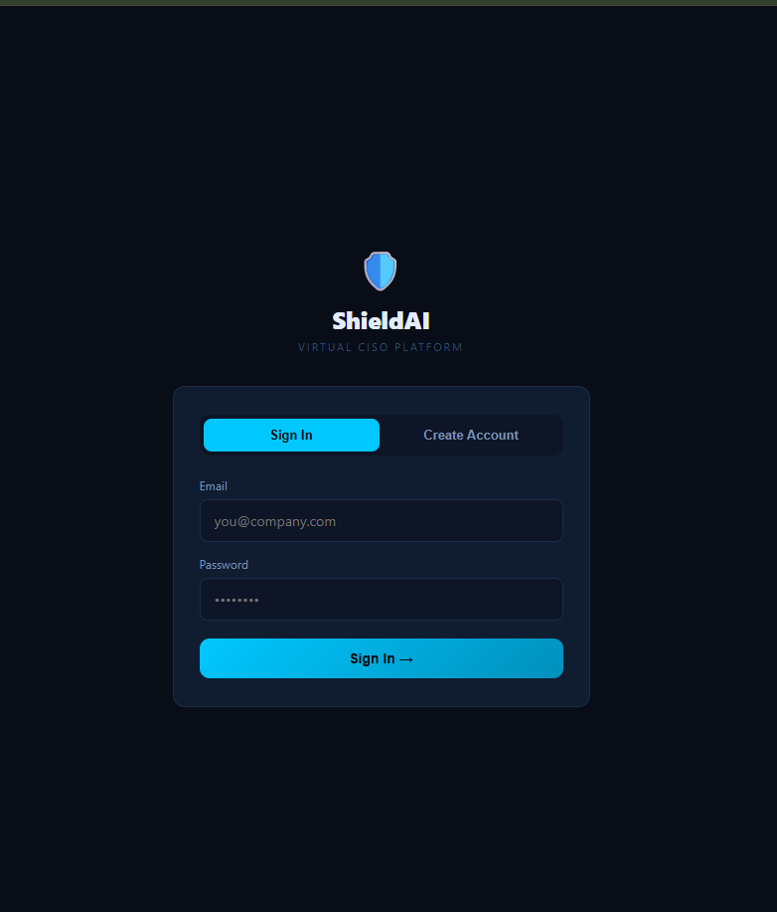
The Problem
Every business is a target. Almost none can afford protection.
A full-time CISO costs $200K–$400K/year.
99% of US businesses are small/mid-sized — they can't afford that.
Yet insurers, customers, and regulators now require a security program.

Slide 3
The pressure just became unavoidable.
Cyber-insurance: Now demands proof of strict security controls to issue or renew policies.
Enterprise Customers: Big clients are pushing heavy security questionnaires down to small vendors.
Expanding Regulation: Compliance standards like HIPAA, CMMC, and state privacy laws carry real penalties.
AI Disruption: AI finally makes expert-level guidance deliverable at a fraction of consulting costs.

Slide 4

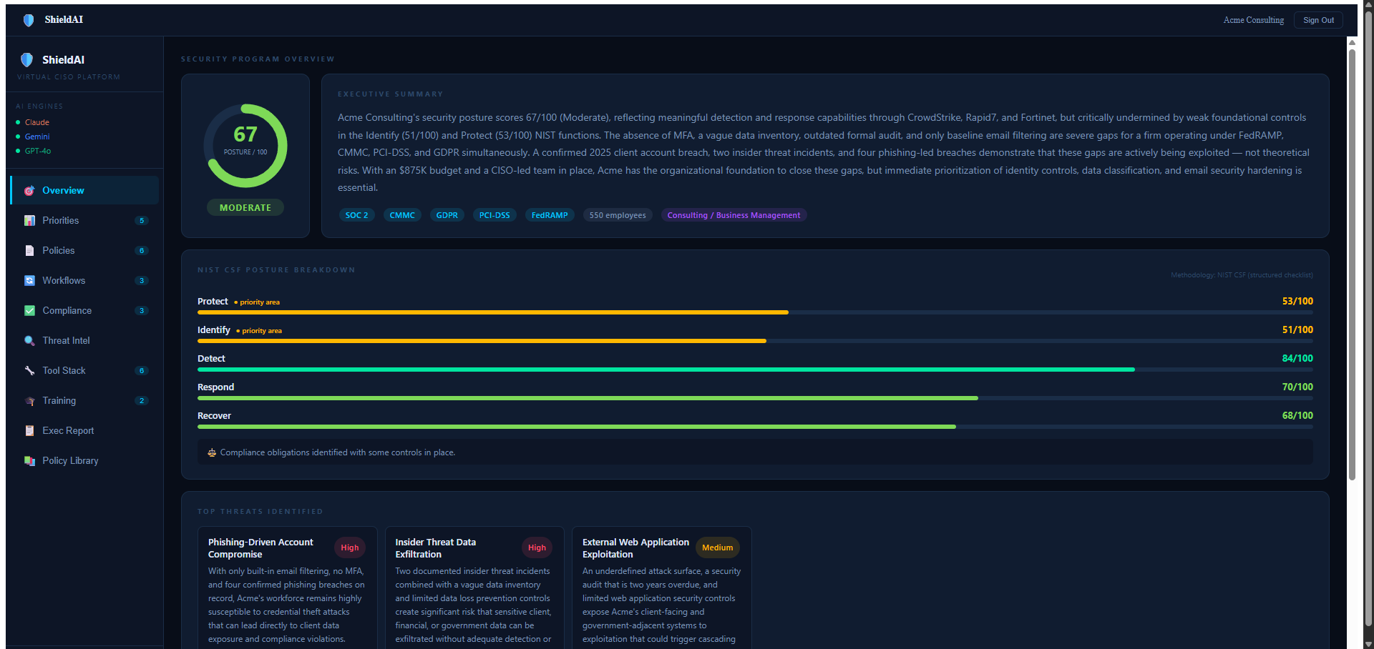
ShieldAI — a virtual CISO, powered by AI, overseen by engineers.
Living Program: Continuous security program, not a static, one-time PDF.
Explainable Metrics: Real, defensible security score based directly on the NIST framework.
Turnkey Assets: Ready-to-use policies, prioritized roadmap, training, and compliance tracking.
Accessible Cost: Priced sensibly as a subscription, completely disrupting traditional consulting.

Slide 5
Assessment → Real Score → Full Program → Ongoing Management
2. Score
Deterministic NIST CSF engine — producing exact, not guessed, results.
4. Manage
Continuous monitoring paired with dedicated expert review.
1. Assess
3. Generate
Conversational intake combined with a structured NIST checklist.
Tailored policies, roadmap, training modules, and exec reports.

Slide 6
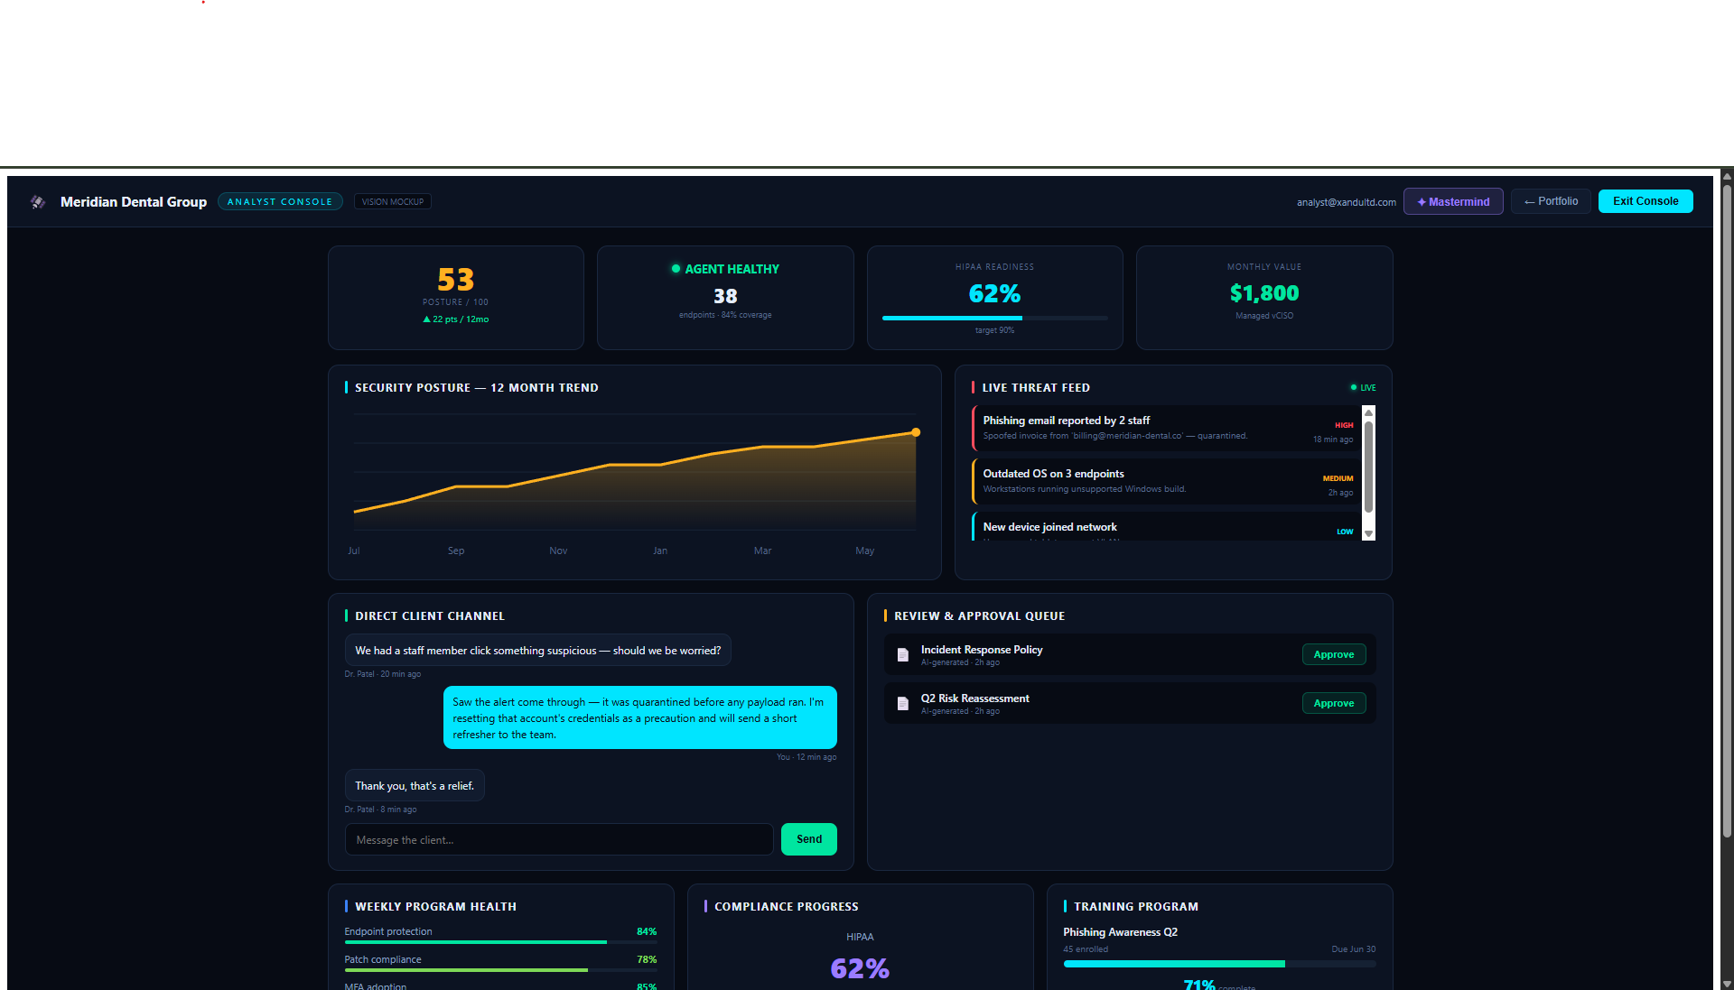
See it work.
Live Demonstration
Client Experience: Watch a client complete an assessment, receive their posture score, and instantly generate a tailored security program.
Platform Vision: See the Analyst Command Center where our engineers monitor active clients, triage live threats, and approve Mastermind AI suggestions.

Slide 7


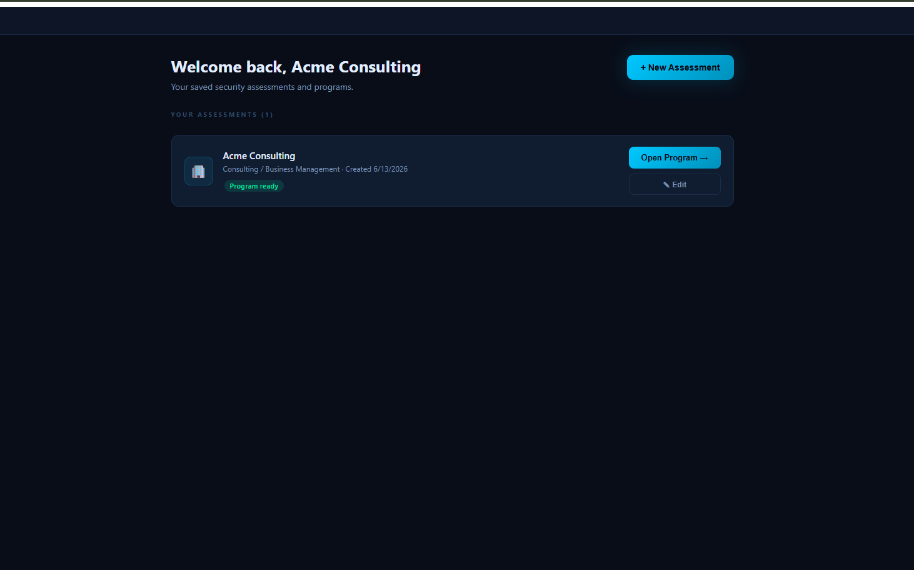
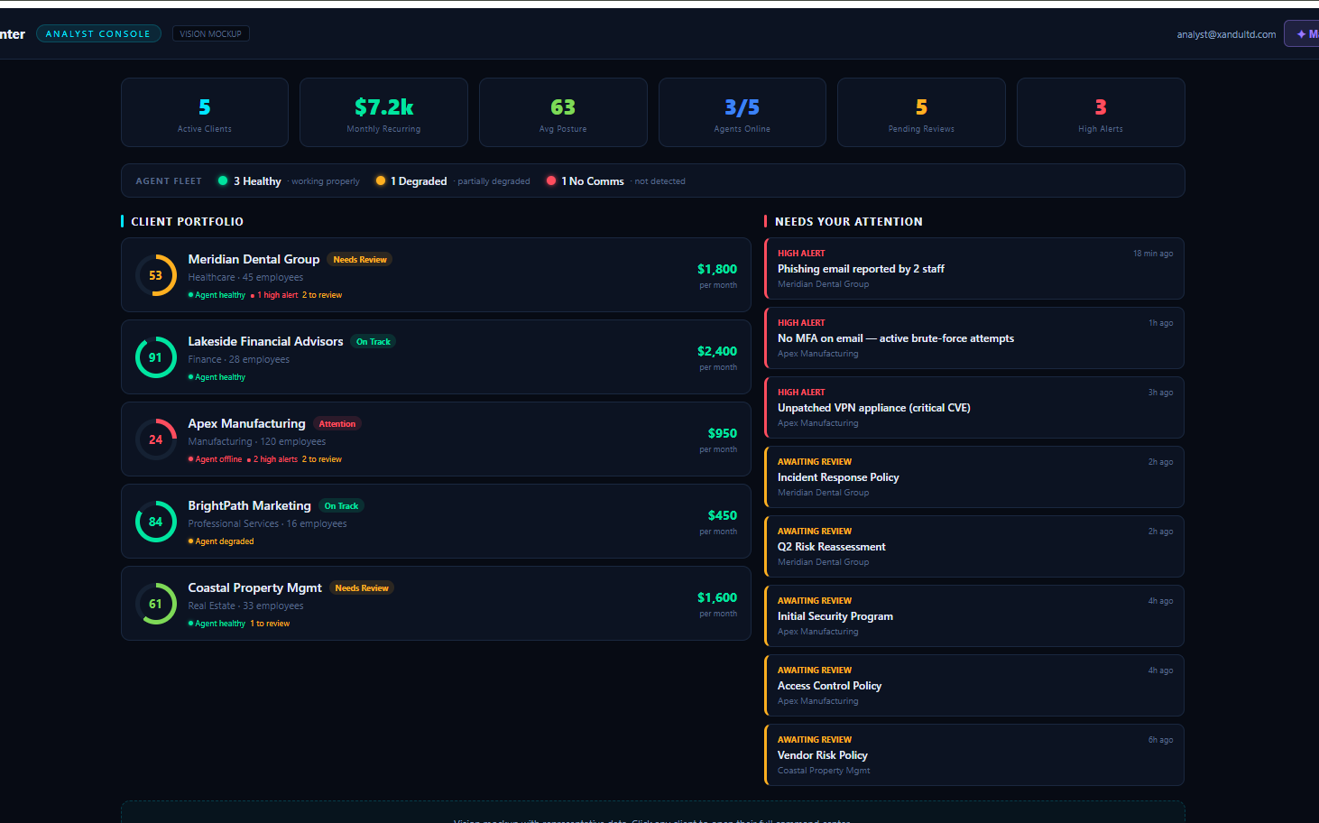
Land with self-serve. Expand to managed programs.
1. Land
2. Expand
3. Scale
Low-cost self-serve assessment gets businesses in the door and proves immediate value.
Clients naturally graduate to managed vCISO plans yielding recurring, higher value revenue.
Our engineers combined with the AI console efficiently run multiple clients each.

Slide 8
Recurring revenue that grows with the relationship.
AI does the heavy lifting, engineers add the high-value judgment.
Tier | Price / Month | Model Dynamics
Self-Serve | $129 | The wedge. Automated assessments, policies, and roadmap generation.
Guided | $599 | Land-and-expand. Adds compliance tracking and periodic engineer reviews.
Managed vCISO | $1,950 | Full program management. High gross margin powered by AI-amplified engineers.

Slide 9

A large, underserved market being forced to act.
The Serviceable Target
33M
There are approximately 5.8 million employer SMBs in the US forming our core market base.
Targeting the 5–250 employee, regulated or insured segment forms our primary serviceable addressable market (SAM).
Small businesses in the US
Even a 1% capture represents a massive ARR opportunity.

Slide 10






Not a wrapper. A defensible system.
The AI is the commodity; the system around it is the moat.
Proprietary Scoring
Human-in-the-loop
Compounding Data
A methodology based on NIST that is fully explainable and trusted by auditors and insurers alike.
Expert oversight guarantees the output is trustworthy enough to sell, effectively limiting our liability.
Every new client assessment and interaction systematically makes the entire platform smarter and stickier.

Slide 11
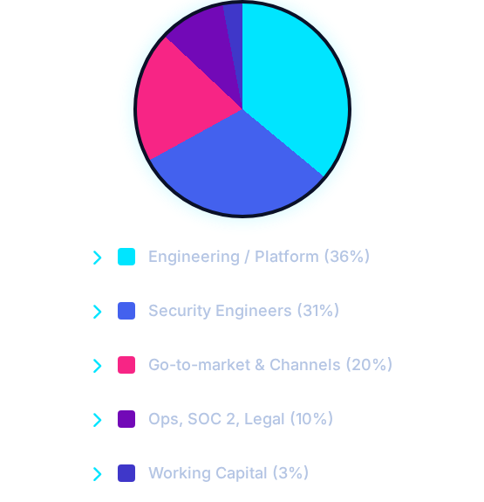
What this raise unlocks.
Now
Client product is live (assessment, scoring, programs, policies).
Next
Convert the analyst console from mockup to live; hire first security engineers.
Then
Deploy network agents, establish automated monitoring, and expand client base.

Slide 12
We're raising $900k to reach Series A readiness.
"A full-time CISO costs a quarter-million dollars a year. ShieldAI delivers that protection for the price of a subscription — and lets a handful of our engineers protect thousands of businesses."
investors@shieldai-vciso.com | www.shieldai-vciso.com

